Slide 1
GIS and Remote Sensing

Slide 2
GIS
Geographical Information System is combination of hardware and software
Store
Manupulate
Analyse
Visualize

Slide 3
Data type
Vector or shape files
Point
Line or segment
Polygons
Raster Data
Pixcel based

Slide 4
Raster Data
Spatial Resolution
Spectral Resolution
Temporal Resoultion
Jpeg, Geotiff, etc

Slide 5

Remote Sensing

Slide 6
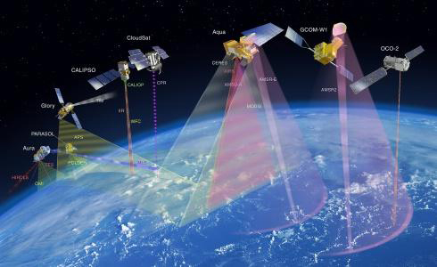
What is remote sensing used for?
Remote sensing is a method for getting information about of different objects on the planet, without any physical contacts with it.
Image Source: cimss.ssec.wisc.edu

Slide 7
What is remote sensing?
Remote sensing is a technology foe sampling electromagnetic radiation to acquire and read non-immediate geospatial data from which to pull info more or less features and objects on his Earths land surface, seas, and air.
- Dr. Nicholas Short

Slide 8
Advantages of Remote Sensing
Provides a view for the large region
Offers Geo-referenced information and digital information
Most of the remote sensors operate in every season, every day, every time and even in real tough weather

Slide 9
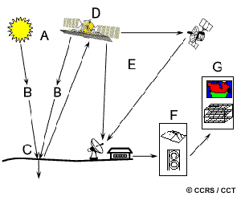
Elements of Remote Sensing
Source:staff.aub.edu.lb

Slide 10
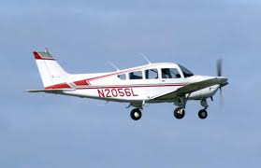
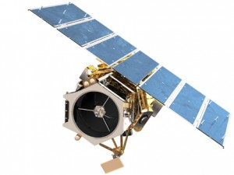
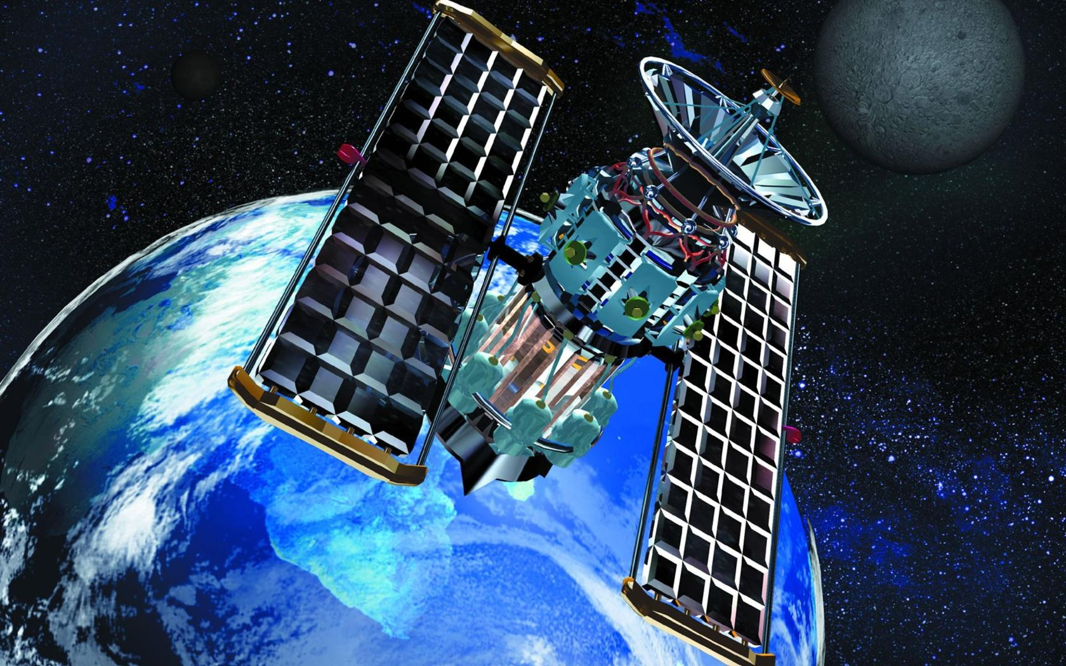
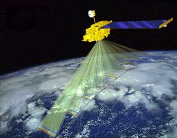
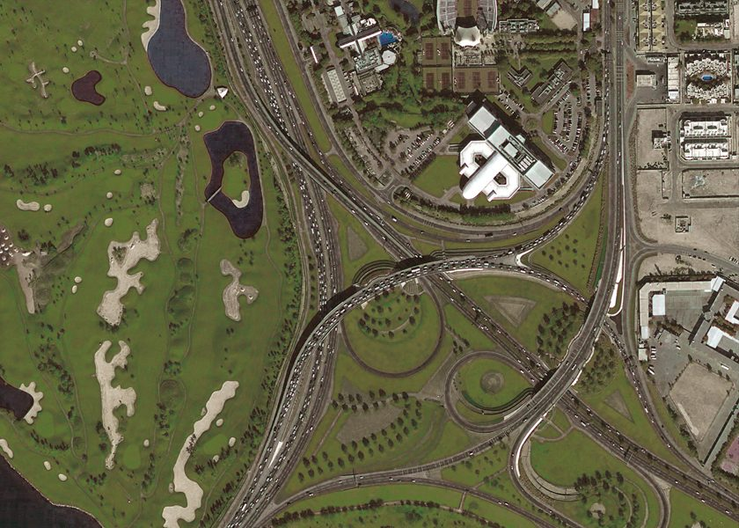
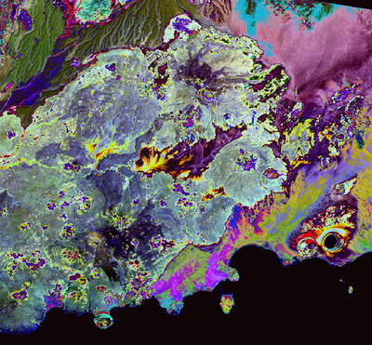
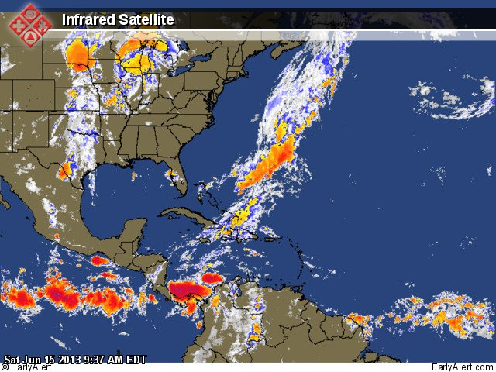
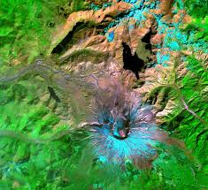
Remotely Sensed Data
Landsat/Ikonos/Quickbard/Aster

Slide 11
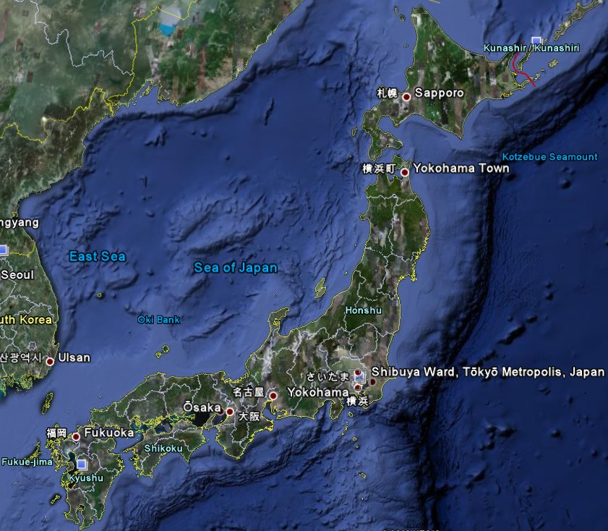
Satellite pictures
Satellite imagery consists of photographs from which collected by satellites.
Japan Satellite View
Image Source: www.wonderwhizkids.com
Image Source: www.loneotaku.net

Slide 12
Satellites offer a Global View
What does satellite imagery give you?
-Information on land cover, land use, habitats, landscape and infrastructure
-multiple engagements by time series
-Mapping and monitoring changes and predict future

Slide 13
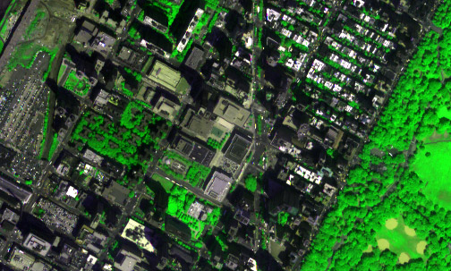
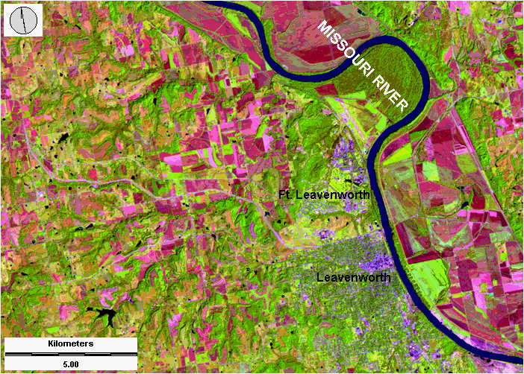
Application of Remote Sensing
Urbanization & Transportation
Urban planning
Roads network and transportation planning
City expansion
City boundaries by time
Wetland delineation
Image source: www.ldeo.columbia.edu
Image source: www.geospectra.net

Slide 14
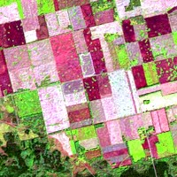
Application of Remote Sensing
Agriculture
The application of remote sensing in agriculture include:
- Soil sensing - Farm classification - Farm condition assessment - Agriculture estimation - Mapping of farm and agricultural land characteristics - Mapping of land management practices - Compliance monitoring
© Wageningen UR 2002

Slide 15
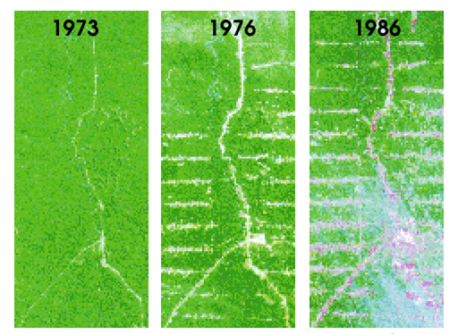
Application of Remote Sensing
Natural resource Management
Forestry: biodiversity, forest, deforestation
Water source management
Habitat analysis
Environmental assessment
Pest/disease outbreaks
Impervious surface mapping
Hydrology
Mineral province
Geomorphology
Md. Bodruddoza Mia

Slide 16
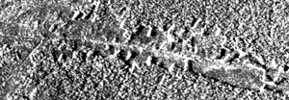
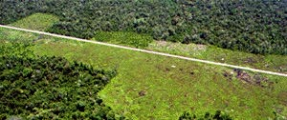
Satellite image of deforestation
Comparison of an aerial photograph (bottom) with a radar image (top) of deforestation along a road
© Wageningen UR 2002

Slide 17
Application of Remote Sensing
Land Use
Land cover means any surface cover on the ground which can include vegetation, urban infrastructure, water, lake, mountain, transportation networks, buildings or any other. The attributes measured by remote sensing techniques relate to land cover, from which land use can be inferred, particularly with ancillary data or a priori cognition.

Slide 18
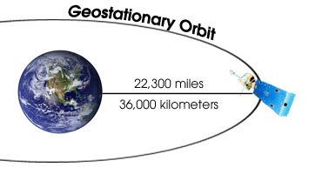
Types of Satellites
Geostationary Satellites
A geostationary satellite is one of the satellites which is getting remote sense data and located satellite at an altitude of approximately 36000 kilometres and directly over the equator.
Image Source: cimss.ssec.wisc.edu

Slide 19
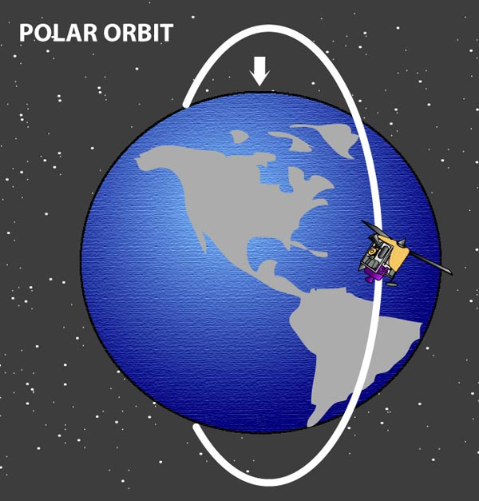
Types of Satellites
Polar-Orbiting Satellites
A polar orbit is a satellite which is located near to above of poles. This satellite mostly uses for earth observation by time.
Image Source: globalmicrowave.org

Slide 20
Some Image Processing Software
ERDAS Imagine
ENVI
ILWIS
ArcGIS

Slide 21
Introduction
Land use – defined by economic terms
Land cover – visible features
Both are important and are really inseparable
We depend on accurate LU/LC data for scientific and administrative purposes

Slide 22
Approaches to Classification
We need some form of automated (rule-based) classification algorithm to allow us to distinguish one surface type from another
Supervised Classification
Unsupervised Classification

Slide 23
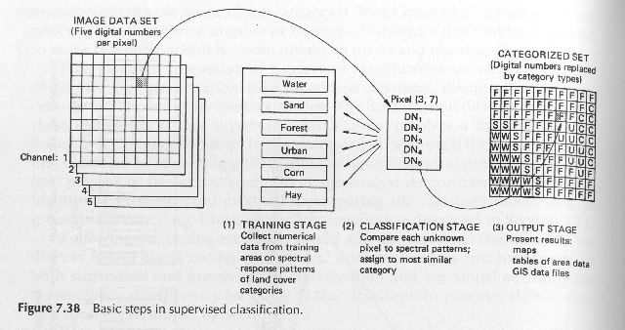
Supervised classification
training stage (significant user input/expertise)
Identify areas of cover types of interest (map, ground survey, spectral characteristics) in bands of an image
From Lillesand, Kiefer and Chipman (2004)

Slide 24
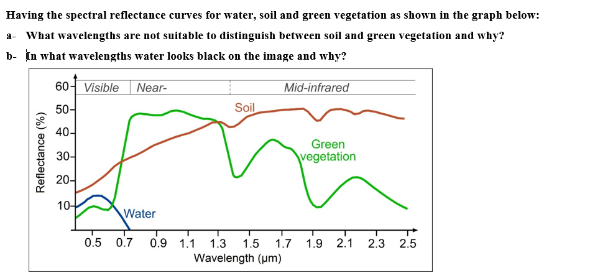
Spectral Reflectance Curve

Slide 25
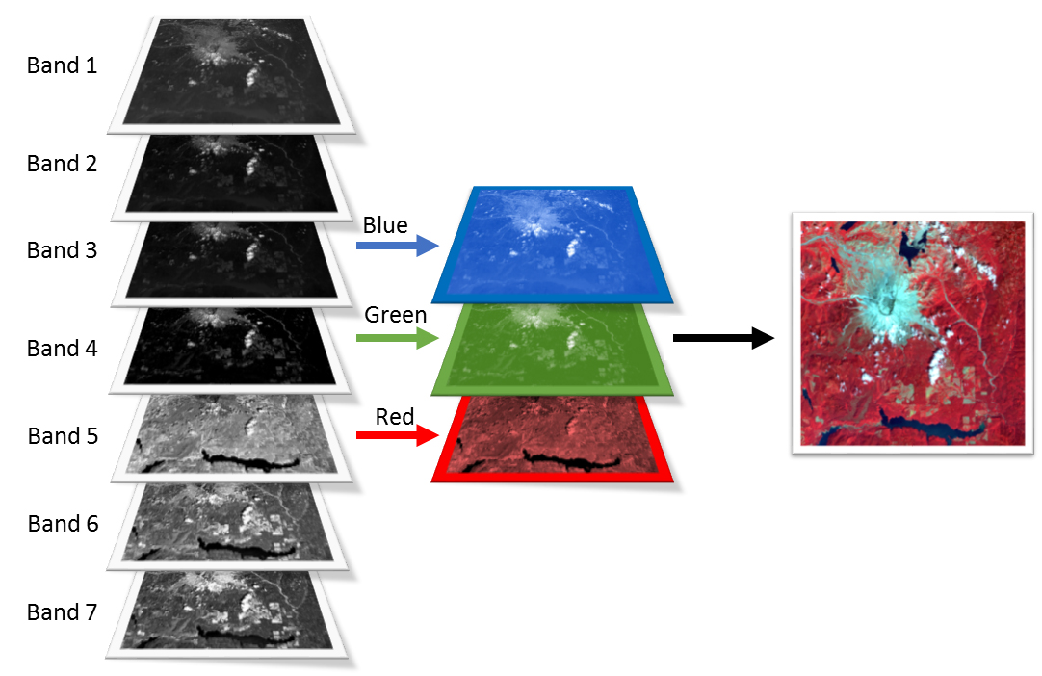
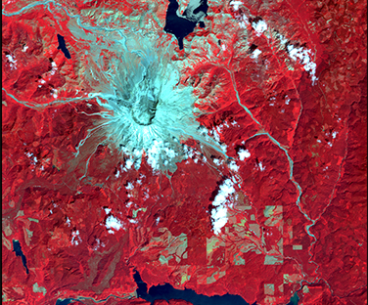
False Colour Composite

Slide 26
Supervised classification: training stage
areas of interest delineated by user
spectral information on the cover types is gathered for these areas
Training data (subset of whole)
These are “classes” we will place all remaining pixels in according to their DN values
Can plot in feature space – do we see clusters?

Slide 27
Supervised classification: classification stage
Need rule(s) to decide into which class we put given pixel
e.g. Minimum distance to means (MDM)
for each land cover class, calculate the mean vector in feature space (i.e. the mean value in each waveband)
Put every pixel into nearest class/cluster
define a limit beyond which a pixel remains unclassified
a simple and fast technique but has major limitations…

Slide 28
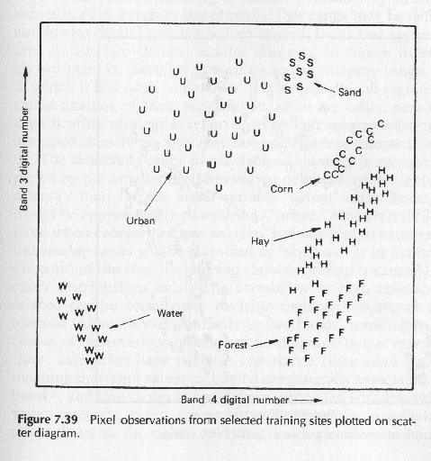
Supervised classification
Feature space clusters
E.g. 2 channels of information
Are all clusters separate?

Slide 29
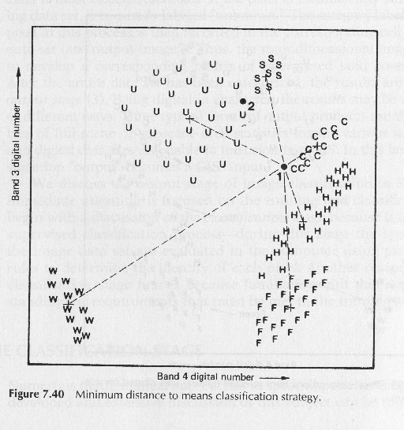
Supervised classification: MDM
Find closest cluster mean for each pixel
Simple and quick BUT what about points 1, 2?
i.e. MDM insensitive to variance of clusters
Can we improve?

Slide 30
Supervised classification: parallelepiped (‘box’)
Assign boundaries around the spread of a class in feature space i.e. take account of variance
typically use minimum/maximum of DN in a particular class to define limits, giving a rectangle in 2D, box in 3D (if we have > 2 bands) etc.
pixels outside of these regions are unclassified (which is good or bad, depending on what you want!!)
problems if class regions overlap or if high covariance between different bands (rectangular box shape inappropriate)
can modify algorithm by using stepped boundaries with a series of rectangles to partially overcome such problems
simple and fast technique
takes some account of variations in the variance of each class

Slide 31
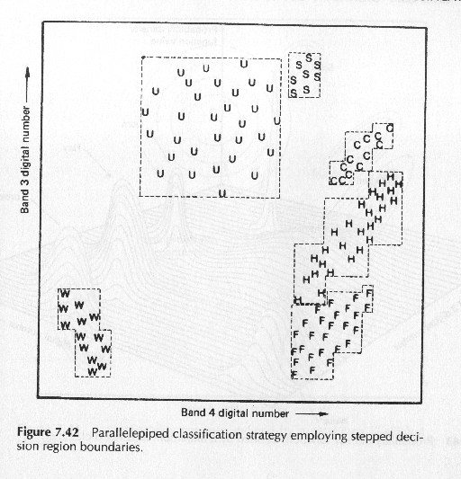
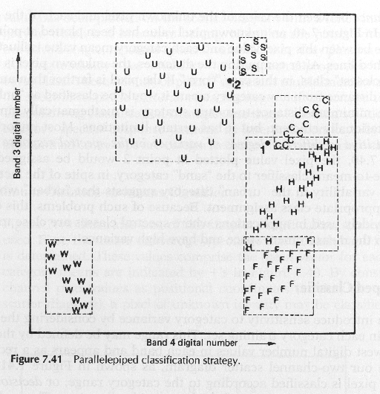
Supervised classification: parallelepiped (‘box’)
Simple boxes defined by min/max limits of each training class. But overlaps……..?
…so use stepped boxes

Slide 32
Supervised classification: Gaussian maximum likelihood
assumes data in a class are (unimodal) Gaussian (normal) distributed
class then defined through a mean vector and covariance matrix
calculate the probability of a pixel belonging to any class using probability density functions defined from this information
we can represent this as equiprobability contours & assign a pixel to the class for which it has the highest probability of belonging to

Slide 33
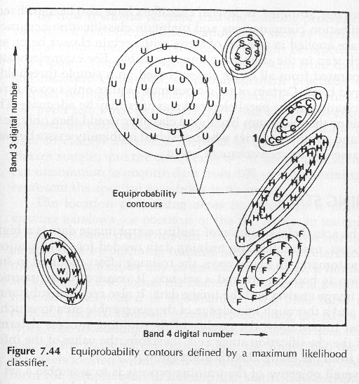
Supervised classification: Gaussian maximum likelihood
Now pixel 1 correctly assigned to corn class
Much more sophisticated BUT is computationally expensive compared to distance methods

Slide 34
Unsupervised Classification (clustering)
Little input from user required (few assumptions)
BUT means results hard to interpret (may not represent classes we recognise)
cluster pixels in feature space based on some measure of their proximity
interpretation of results / assigned classes
can be useful, e.g. in picking up variations within what would otherwise be distinguished as a single class e.g. stressed/unstressed crop in a single field)
clusters can be of little intrinsic value in themselves
e.g. sunlit trees, shaded trees is perhaps not a useful discrimination if one simply wants to classify 'trees', and so clusters may have to be combined

